Slide 1

Text-Based motion detection
Datasets & current advances

Slide 2
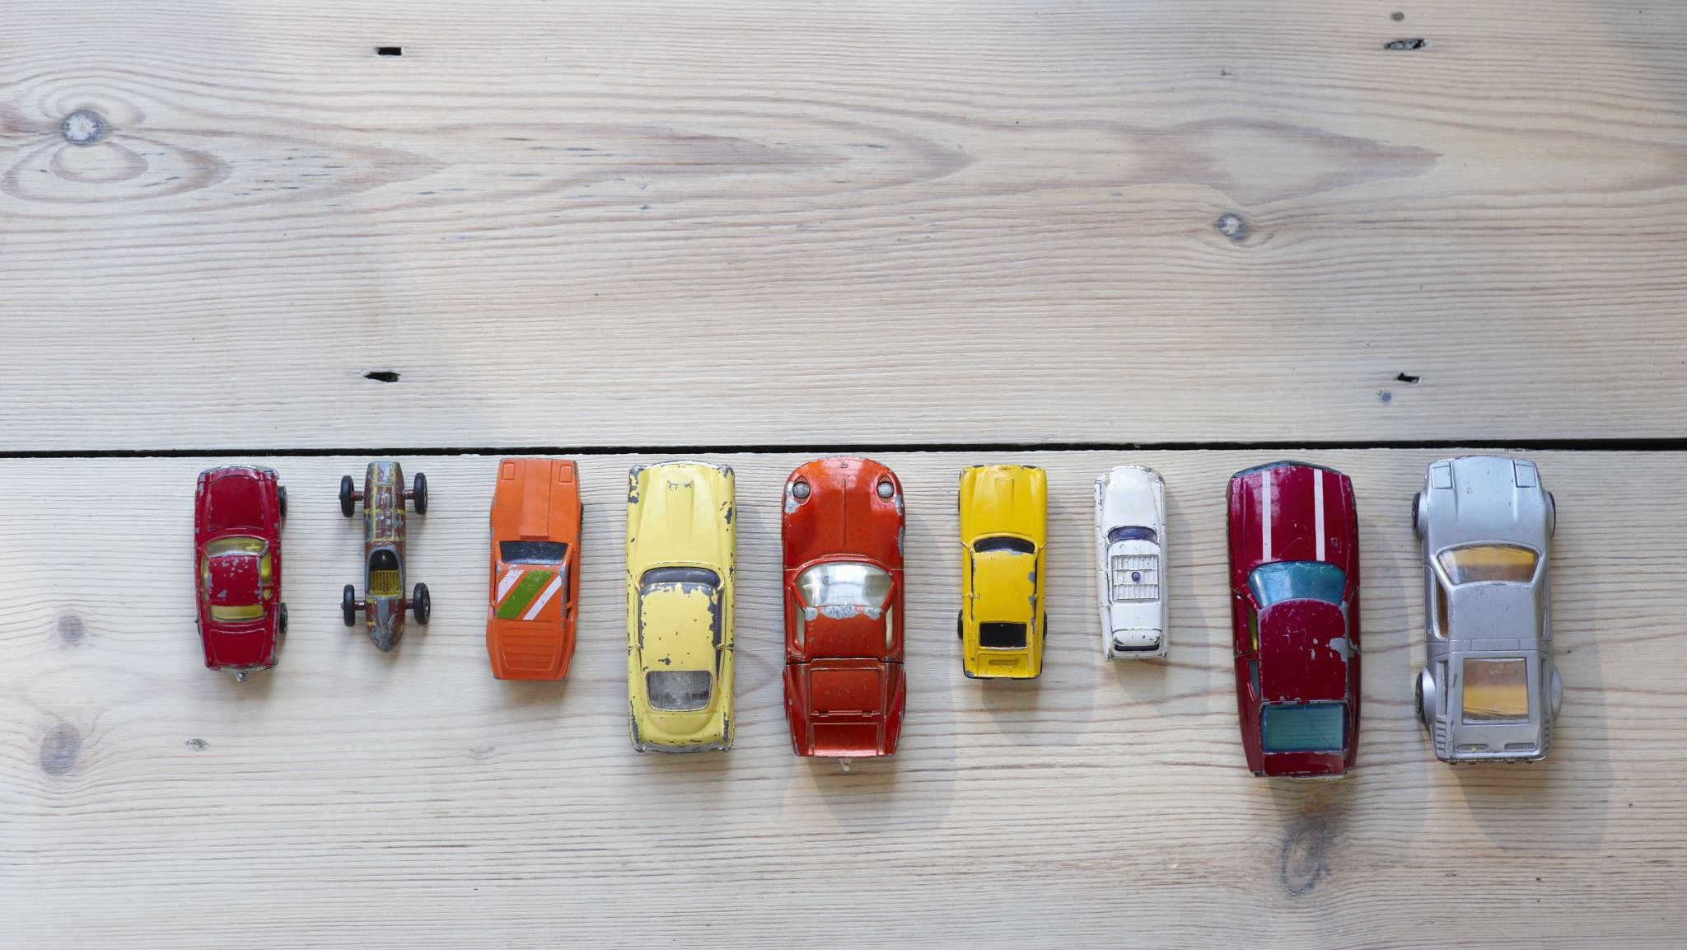
Main Models

Slide 3
Types of ED models
1-Discrete Emotion Models (DEMs)
2-Dimensional Emotion Models (DIEMs)

Slide 4
Discrete Emotion Models
The discrete model of emotions involves placing emotions into distinct independent classes
Discrete Emotion Models:
The Paul Ekman Model
6 basic emotions: happiness, sadness, anger, disgust, fear and surprise
The Robert Plutchik Model
Added 2 emotions (acceptance and trust) on the 6 proposed by Ekman and created new emotions using combinations of these emotions
OCC Model
Added 16 more emotions to the emotions proposed by Plutchik and Ekman and each emotion has a degree of intensity

Slide 5
Dimensional Emotions Models
The dimensional model presupposes that emotions are not independent and that there exists a relation between them hence the need to place them in a spatial space
Dimensional Emotions Models:
Russel and Mehrabian Model:
Three-dimensional model where third dimension represents the degree of control individuals had over their emotions
Russel Model:
Two-dimensional circle called circumplex of affect

Slide 6
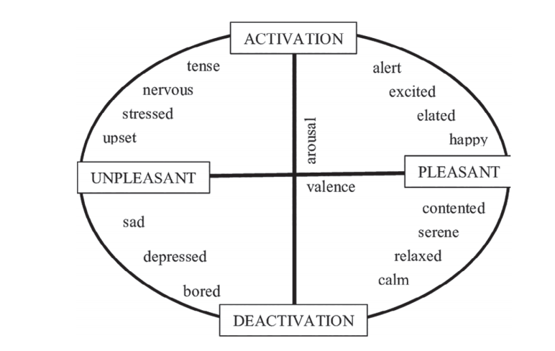
Russel Dimensional Emotion Model

Slide 7
Techniques And Algorithms
LSTM to CNN (65.97% Accuracy)
SVM and NB (59.2% Accuracy)

Slide 8

Publicly available datasets for detecting emotions in texts

Slide 9
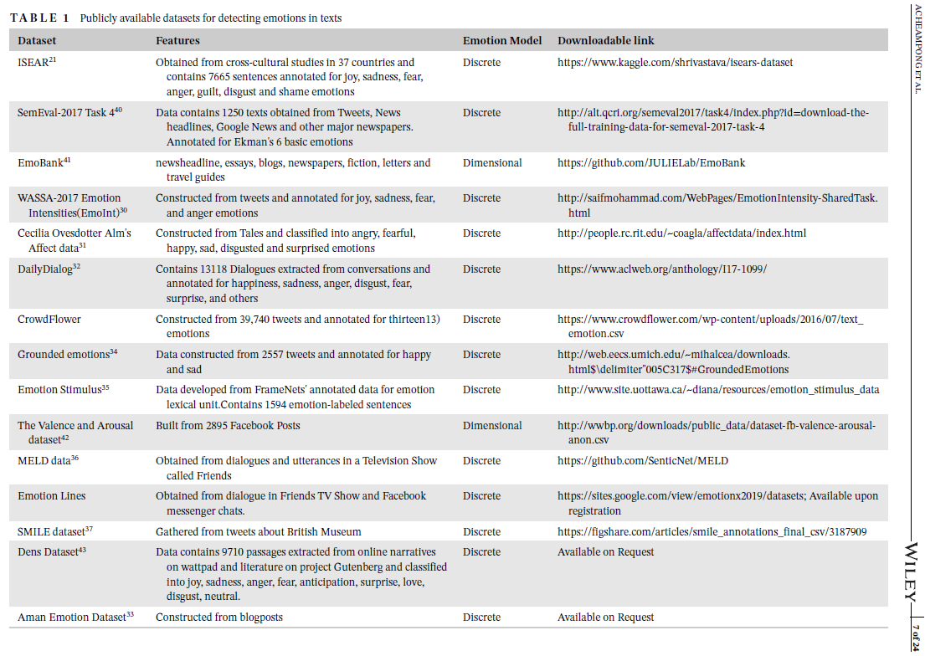

Slide 10

Summary of current advances in text-based emotion detection

Slide 11
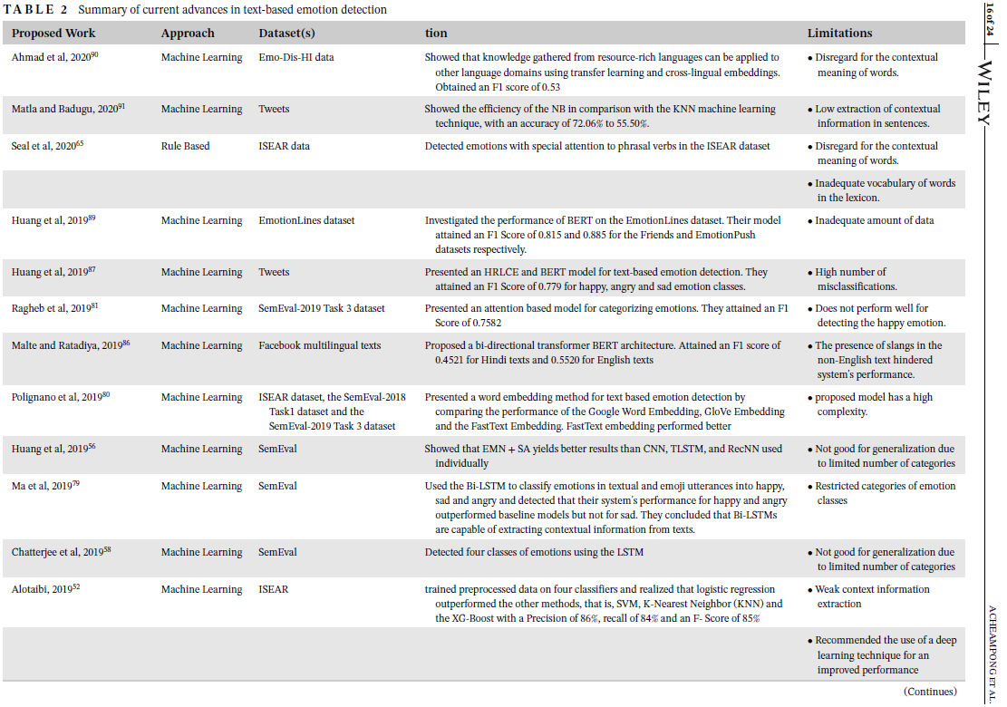

Slide 12
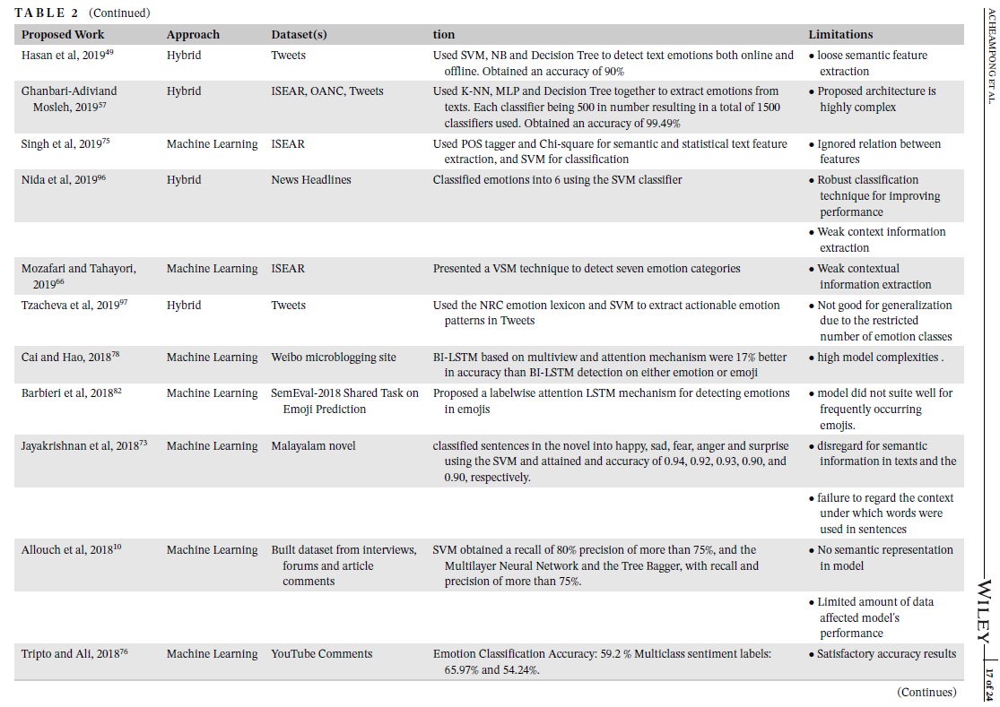

Slide 13
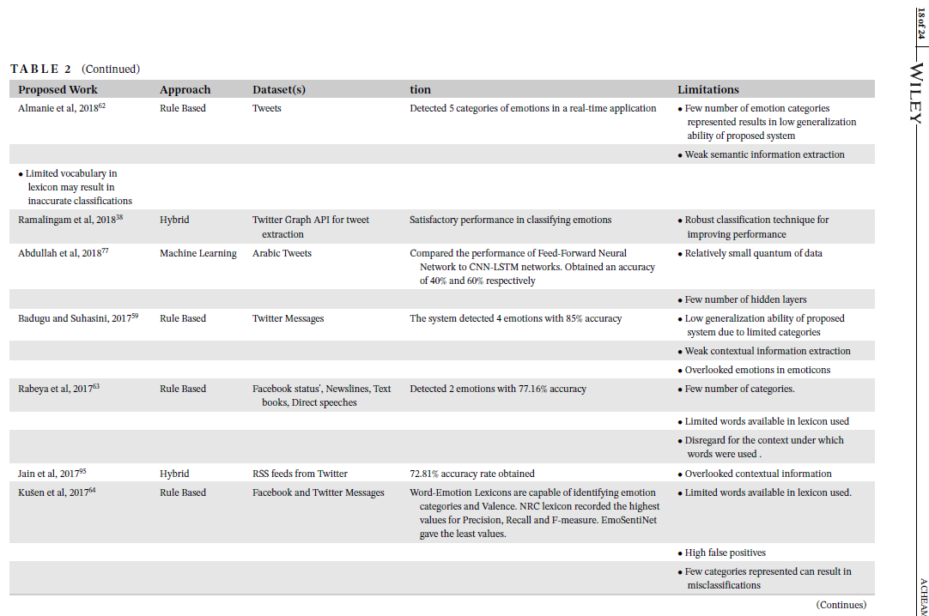

Slide 14
